Slide 1

MSPM’S
DEOGIRI INSTITUTE OF ENGINEERING
AND MANAGEMENT STUDIES
Department of Computer Science and Engineering.
THEORY OF COMPUTATION
Presentation on:
Construction Of the DFA Accepting String ”abb”
Submitted by:
Name : Siddhi Gaud(36128)
Manisha Wadekar(36127)
Under the Guidance of
prof. S.M. Chavan
Asst. prof. Department of CSE
(Deogiri Institute of Engineering And Management Studies)

Slide 2
INTRODUCTION
Theory of Computation | Finite Automata Introduction
Finite Automata(FA) is the simplest machine to recognize patterns.
A Finite Automata consists of the following :
Q : Finite set of states.
∑ : set of Input Symbols.
q : Initial state.
F : set of Final States.
δ : Transition Function.
Formal specification of machine is { Q, ∑, q, F, δ }.
FA is characterized into two types:
Deterministic Finite Automata (DFA)
Nondeterministic Finite Automata(NFA)

Slide 3
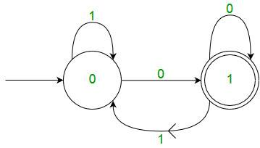
Deterministic Finite Automata (DFA)
DFA consists of 5 tuples {Q, ∑, q, F, δ}.
Q : set of all states.
∑ : set of input symbols. ( Symbols which machine takes as input )
q : Initial state. ( Starting state of a machine )
F : set of final state.
δ : Transition Function, defined as δ : Q X ∑ --> Q.
In a DFA, for a particular input character, the machine goes to one state only. A transition function is defined on every state for every input symbol. Also in DFA null (or ε) move is not allowed, i.e., DFA cannot change state without any input character.
One important thing to note is, there can be many possible DFAs for a pattern. A DFA with minimum number of states is generally preferred.
For example, below DFA with ∑ = {0, 1} accepts all strings ending with 0.

Slide 4
Language accepted by DFA
A string w is accepted by a DFA < Q , ∑, q₀ , δ , A > , if and only if δ*( q₀ , w ) belongs to A . That is a string is accepted by a DFA if and only if the DFA starting at the initial state ends in an accepting state after reading the string.
Design a DFA for the language accepting strings ending with ‘abb’ over input alphabets ∑ = {a, b}
Solution:- Regular expression for the given language = (a + b)*abb
Step-01:
All strings of the language ends with substring “abb”.
So, length of substring = 3.
Thus, Minimum number of states required in the DFA = 3 + 1 = 4.
It suggests that minimized DFA will have 4 states.

Slide 5
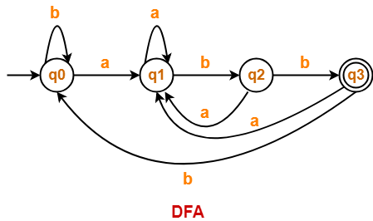
Step-02:
We will construct DFA for the following strings-
abb
aabb
ababb
abbabb
Step-03:
The required DFA is-

Slide 6
CONCLUSION
Hence we are doing C program to design DFA which accepts stings starting with one symbol and ending with another symbol.
Such As :” abb”
Github link:

Slide 7
THANK YOU!

